Slide 1
Vehicle Detection

Slide 2
Intro to Transfer Learning
To get a ML model to perform more complex tasks, two things are needed:
A deep (many layered) network
A lot of varied training data
Thus, building a robust model for a complex task from scratch requires a large dataset and a lot of computation time.
Transfer learning is a common technique which allows the use of large, pre-trained networks to give us a starting point for our model.
With only a few architecture changes and much fewer training hours, we can create a task specific network that can perform much more complex tasks.

Slide 3
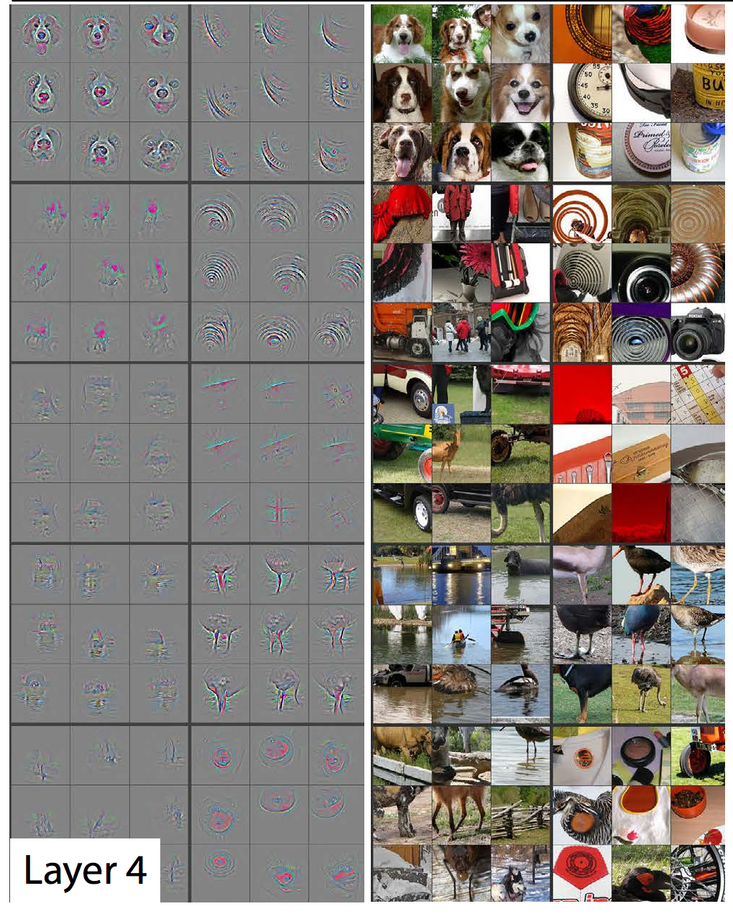
Intro to Transfer Learning
A neural network can be thought of as a feature extractor:
Consider a Convolutional Neural Network (CNN) that is trained to predict the presence or absence of dogs in a neural network.
The final layer will receive input from some large number of neurons in the previous hidden layer and its output will be a value interpretable as a probability of the input image containing a dog.
It stands to reason that the backbone of the network (the hidden layers) is capable of identifying features of the input image that are present specifically in dogs (e.g. eyes, snout, ears, body shape).

Slide 4
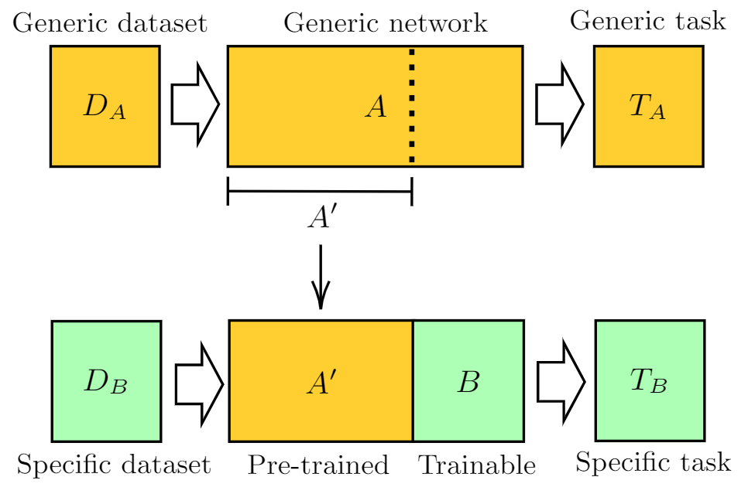
Intro to Transfer Learning
We can use the backbone of a large pre-trained model as a general feature extractor.
The task specific output layer of the network can be changed to suit our goal (classification of different classes, regression, etc.).
We “freeze” the weights in the backbone network such that training only changes the weights of our custom output layer
Hopefully, the combination of a robust feature extractor and additional task specific training results in a powerful network with much less training time and fewer required training data samples

Slide 5
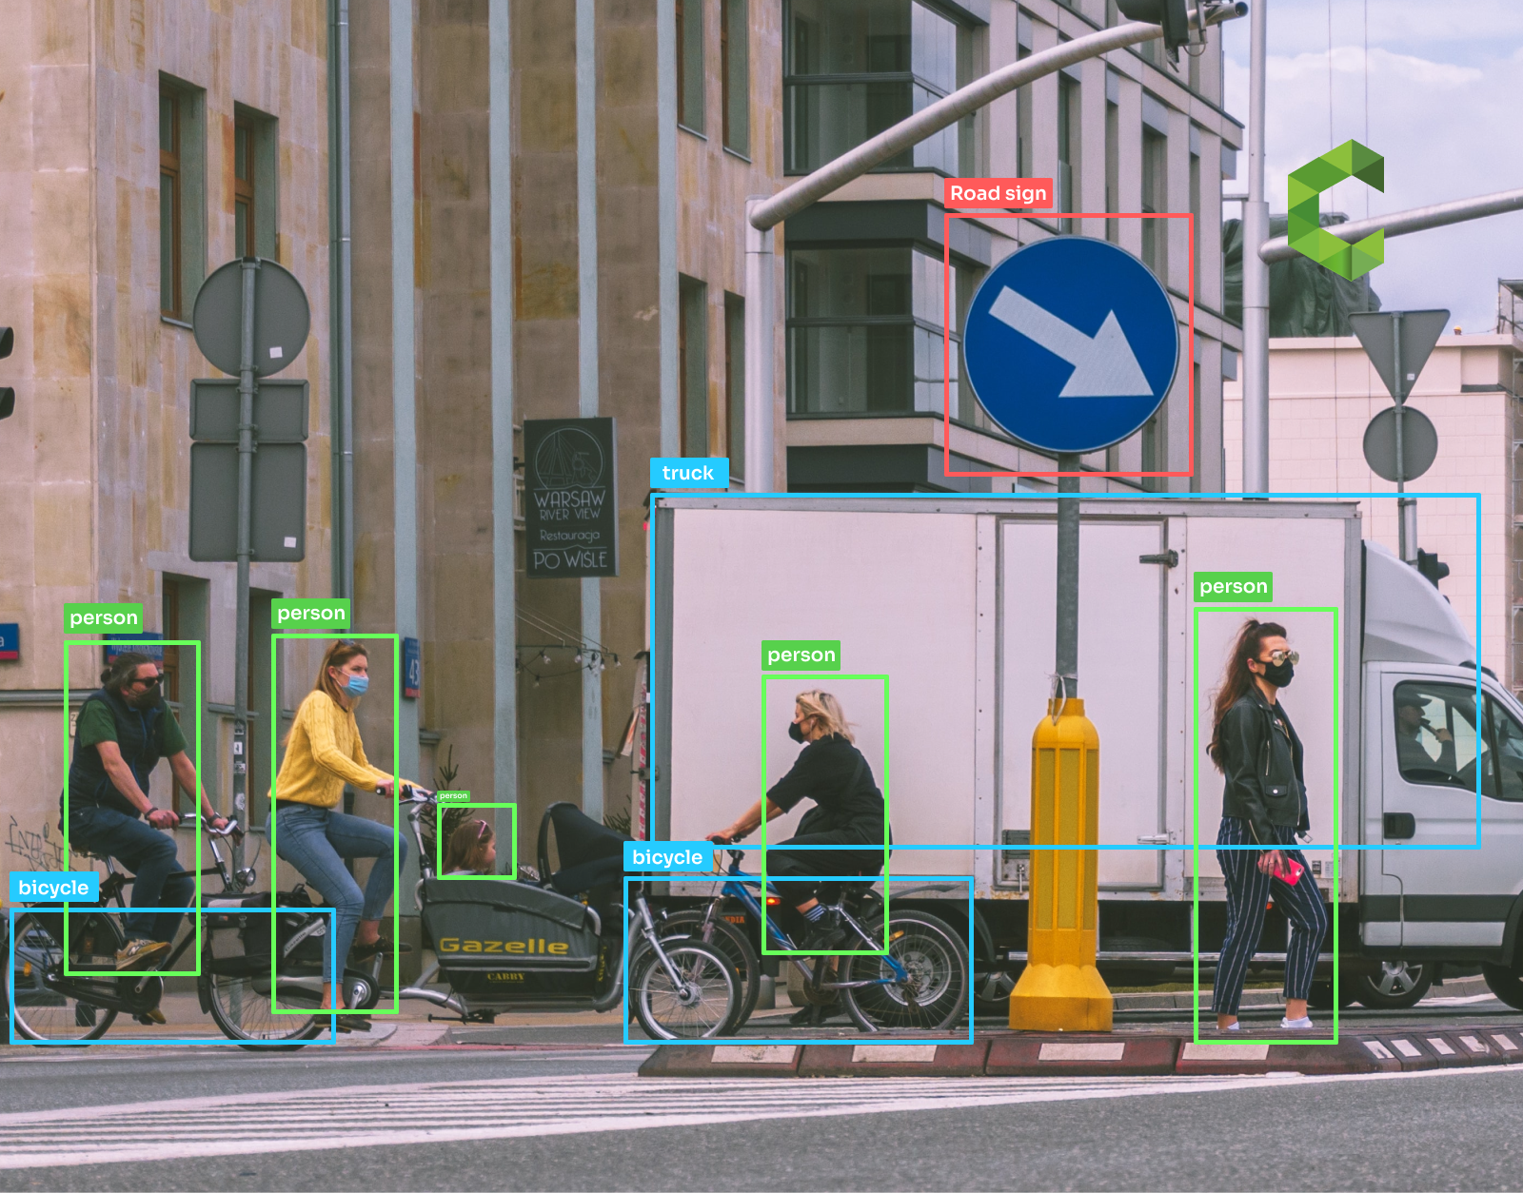
Intro to Object Detection
In certain applications, it is not sufficient to identify whether there is some object present in an image.
We may also want to determine where the object is in the image.
This may be done in a multiclass classification setting, where multiple objects of different types need to be located.
This describes the task of object detection: create a model to detect instances of semantic objects in images.
Object detection has many applications:
Activity recognition
Security and surveillance
Face detection
Object tracking (sports)
Collision avoidance

Slide 6
Region-based Convolutional Neural Network (R-CNN)
Object detection models have quite complicated architectures, and thus we’ll skip the fine details.
CNNs are a network architecture which use the mathematical convolution operation to process data with a grid-like topology.
Since digital images are stored as pixel arrays with direct spatial relationships between array layout and image appearance, image processing tasks are well suited to CNNs.
More about CNNs tomorrow!

Slide 7
R-CNN
Models for object detection using regions with CNNs are based on the following three processes:
Find regions in the image that might contain an object – region proposals.
Using convolution layers, extract features from the region proposals.
Classify the objects using the extracted features.
Object detection is both a classification and a regression task:
Categorization of objects into their appropriate classes.
Predict the location of a bounding box around the object.

Slide 8
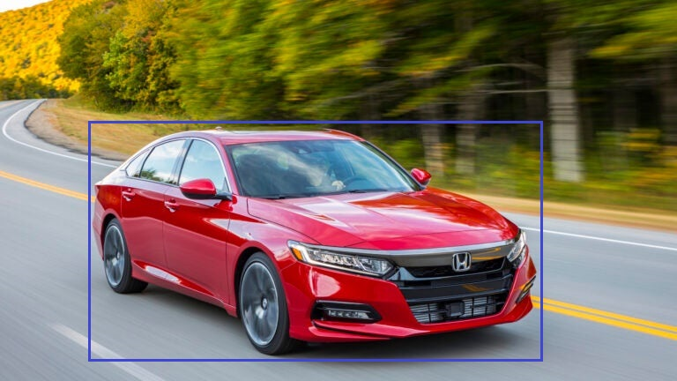
Bounding Box
0
x
0
y
y_{min}
y_{max}
x_{min}
x_{max}

Slide 9
Code
Open vehicle_detection_transfer_learning_template.ipynb
Cell 1 imports necessary libraries and packages.
Cell 2 records some housekeeping info, like our number of classes, compute device, paths to our data files, and batch size.
Cell 3 defines our custom data set object, which is used to associate annotations with images and provide data/label samples during training. Then the data set and data loader objects are instantiated.
These cells do not need any code from you

Slide 10
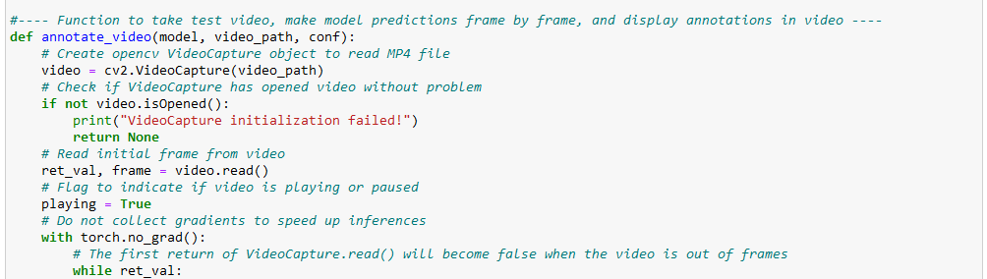
Code
Cell 4 defines some helper functions to
Process images into tensors.
Impose the predicted bounding boxes onto an image.
Run inferences on a series of frames (video).
Complete the function annotate_video as follows:

Slide 11
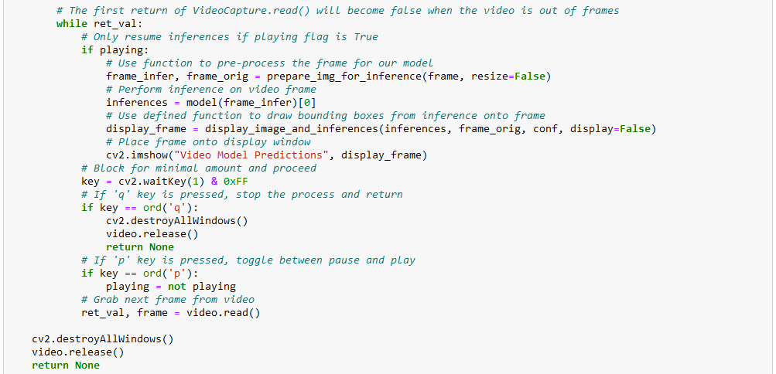
Code
Complete the function annotate_video as follows:

Slide 12
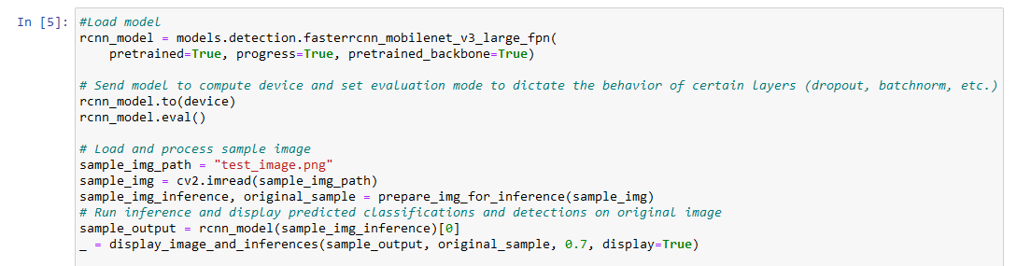
Code
Cell 5 loads our pretrained model and performs a sample inference on it.
Complete this cell as follows:

Slide 13
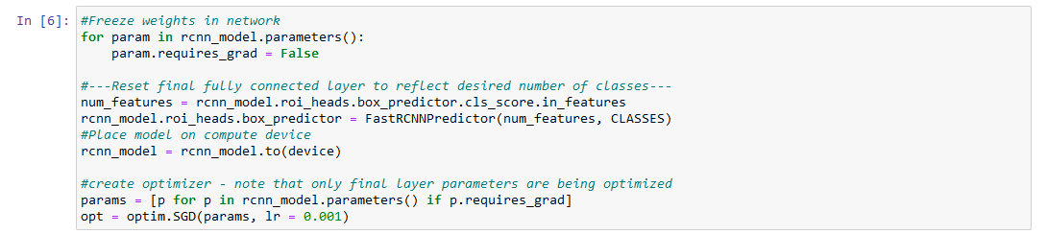
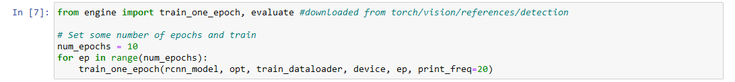
Code
Cell 6 freezes the weights in the network and replaces the final layer with a new output layer with our desired number of classes.
Cell 7 uses a given training function to train for some number of epochs.
Complete these cells as shown:

Slide 14
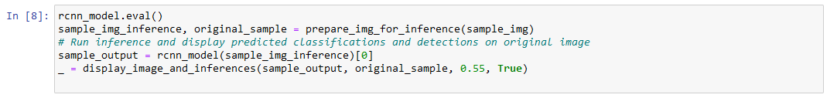

Code
Cell 8 performs an inference on our sample image.
Cell 9 calls our custom function to perform inference on a test video.
Complete cells as follows:
May need to adjust confidence level.

Slide 15
Code
When you run cell 9, a new window will pop up which will play the test video with bounding boxes imposed.
Press the ‘P’ key to toggle between pause and play!
Press the ‘Q’ key to close video!
Rerun the final cell to replay the video!

Slide 16
Conclusion
Can change optimizer, batch size, and training epochs to improve results!
You could make your own small training data set and create an object detection model for your own object!
Can also use pre-trained models for inference, read their documentation and see what objects they are already trained to detect.
Transfer learning makes large models for complex tasks accessible to everyone!

Slide 17
Resources
This PyTorch tutorial is a good start to transfer learning for computer vision tasks, and served as the basis of this demo.
This documentation, and following some links on this page, give an overview of the data requirements and information on the format of the output.
CVAT is a free online resource for manually annotating images for object detection and other computer vision tasks. Many tutorials for using CVAT exist online, just make sure you know what data format your pre-trained model requires!

